Slide 1

AASD 4000
Machine Learning - I
Applied AI Solutions Developer Program

Slide 2
Module 10
Ensemble Learning
Vejey Gandyer

Slide 3
Agenda
Ensemble
Voting
Averaging
Weighted Averaging
Stacking
Blending
Bagging
Boosting

Slide 4
Ensemble
What is it?

Slide 5
What is Ensemble?
Combine the decisions from multiple models to improve the overall performance
Voting
Averaging
Weighted Averaging
Stacking
Blending
Bagging
Boosting

Slide 6
Voting

Slide 7


Voting
(discrete)
Used for Classification problems
Multiple models are used to make predictions for each data point
Every prediction = 1 vote
The class label that got the maximum vote is the final prediction
Mode (Maximum occurrence of a class label)
5 models
4 No loan
1 Yes Loan
No Loan

Slide 8
Averaging

Slide 9

Averaging
Continuous
Used for Regression problems
Multiple models are used to make predictions for each data point
Every prediction = 1 vote
The average of class predictions from models is the final prediction
Mean(Average of class labels from different models)

Slide 10
Weighted Averaging

Slide 11


Weighted Averaging
Used for Regression problems
Multiple models are used to make predictions for each data point
Every model prediction != 1 vote but weighted vote
The multiplication of class predictions with its model's weightage is the final prediction
Weighted Average of class labels from different models
Avg = (550000+500000+600000)/3
Weighted avg=((0.4x550000)+0.3x500000)+(0.3*600000))/3

Slide 12
Stacking

Slide 13
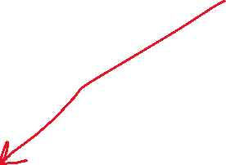



Stacking
Used for Classification and Regression problems
Layered level approach of models are stacked
Multiple models are used to make predictions in level 0
In the top level 1, a simple Logistic Regression is applied over the predictions of Level 0 models
The stacked model predictions is the final prediction
Level 1
Level 0
Usually stop at level 2

Slide 14





Stacking
Split the data into training and test sets. The training data is further split into K-folds just like K-fold cross-validation.
A base model(e.g k-NN) is fitted on the K-1 parts and predictions are made for the Kth part. (out-of-fold prediction)
This process is iterated until every fold has been predicted.
The base model is then fitted on the whole train data set to calculate its performance on the test set.
Repeat the last 3 steps for other base models.(e.g SVM,decision tree, KNN )
Predictions from the train set are used as features for the second level model.
Second level model (Meta-model) is used to make a prediction on the test set.
Not Random forest

Slide 15
Blending

Slide 16


Blending
Used for Classification and Regression problems
Level-0 models (Base-models) fit on the training data and its predictions are compiled
Level-1 models (Meta-model) learns how to best combine the predictions of the base models
Heuristic rule -> introduce bias
Final prediction

Slide 17





Blending
The train set is split into training and validation sets.
Base Model(s) are fit on the training set.
The predictions are made on the validation set and the test set.
The validation set and its predictions are used as features to build a meta-model.
This model is used to make final predictions on the test and meta-features.
Meta-model sees only the predictions of the models in level 0
won’t go beyond level 2

Slide 18
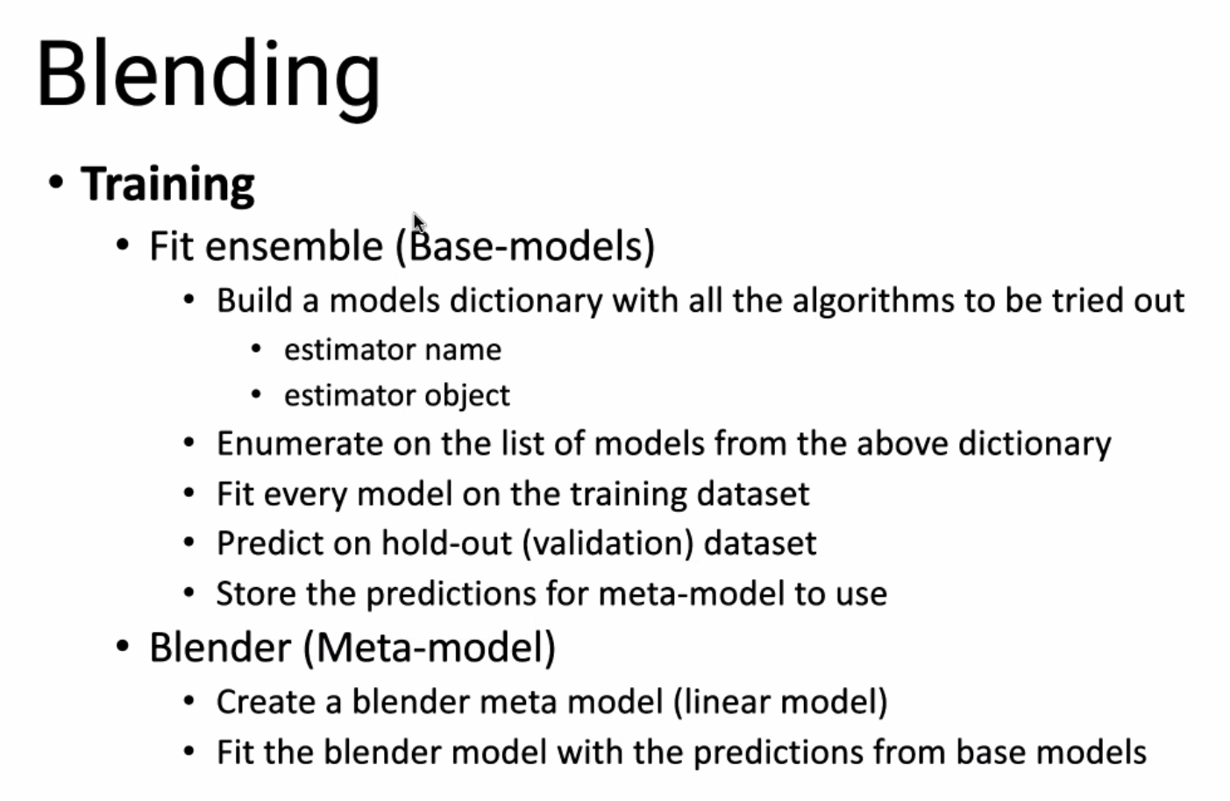




Don’t use DNN

Slide 19
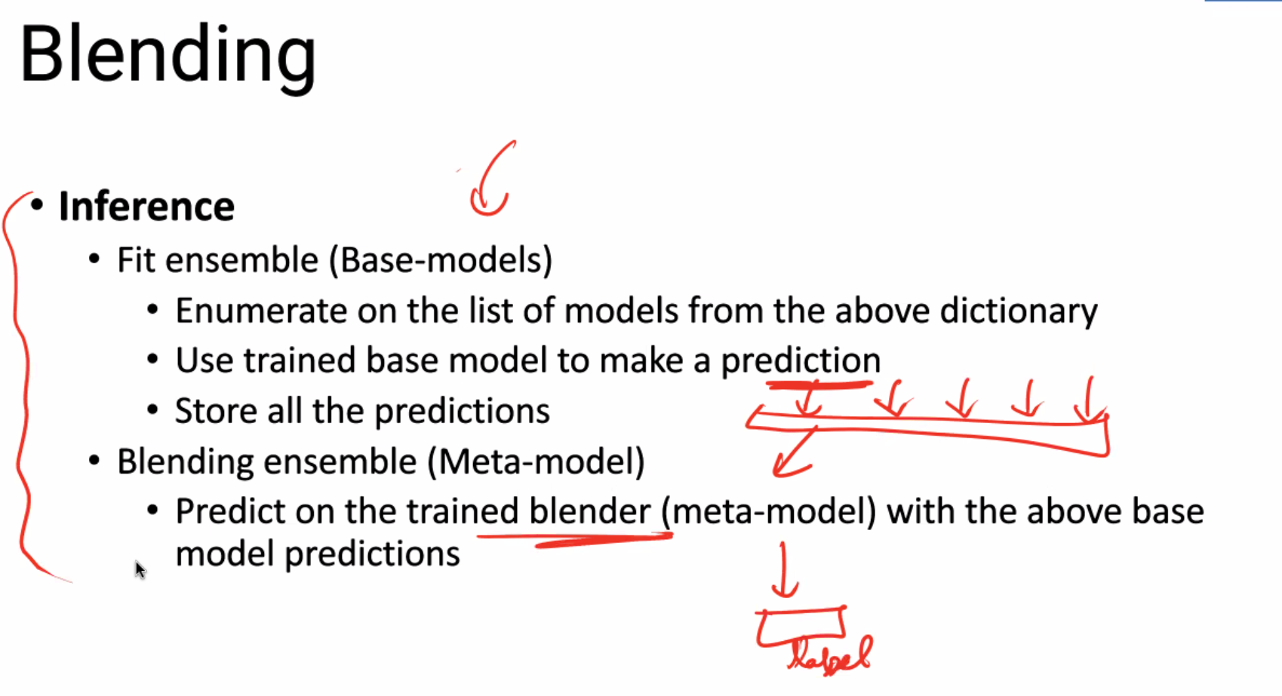

Slide 20




Blending Vs Stacking
Blending: Meta-model is trained on predictions made on a holdout dataset (x_val)
Stacking: Meta-model is trained on out-of-fold predictions made during k-fold cross-validation

Slide 21
Bagging

Slide 22


Bagging
Used for Classification problems
Several decision trees are built with
- random subsets of data for building decision trees
- random subsets of features used as splitting criteria for decision trees
Several weak learners' predictions are averaged into a single final prediction
Example: RandomForest
features

Slide 23
Boosting

Slide 24




Boosting
Used for Classification problems
Prediction error in the previously built model is corrected in subsequent model-building exercise
At every iteration, errors from previous step are considered and used to learn new patterns at subsequent steps
After several iterations, a robust model with minimal errors is built
Example: XGBoost, LightGBM
regression
iterations
High-priority

Slide 25
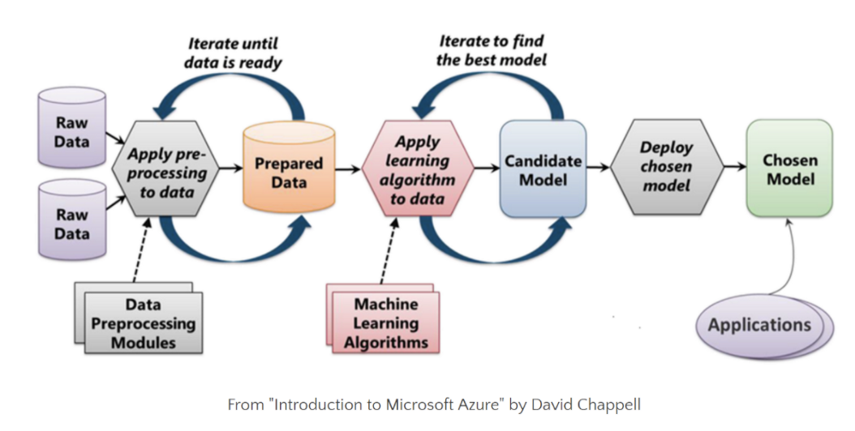
Machine Learning Process

Slide 26
Further Reading
Scikit-learn documentation
https://scikit-learn.org/stable/modules/ensemble.html
Python Data Science Handbook by Jake Vanderplas

